Slide 1
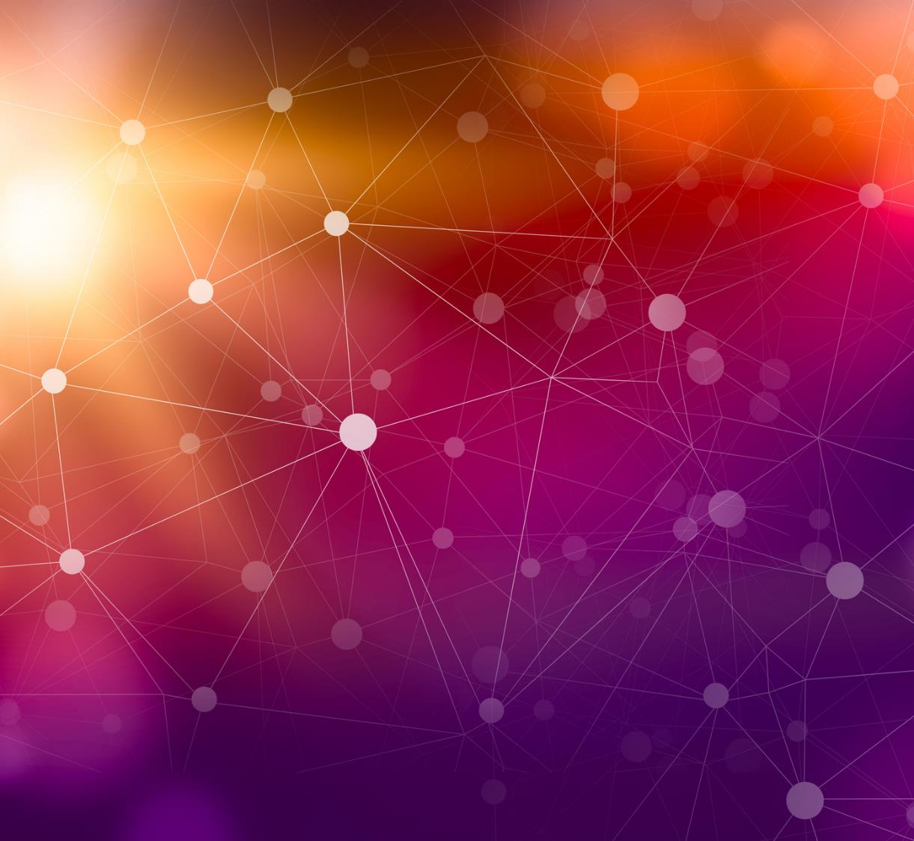
How does machine learning affect human decision?
By
TOYIN

Slide 2
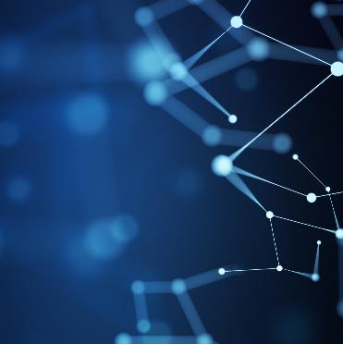
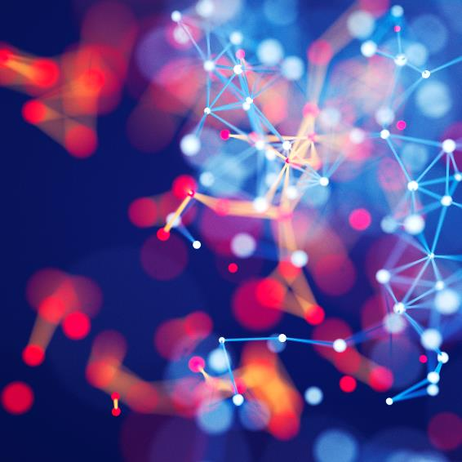
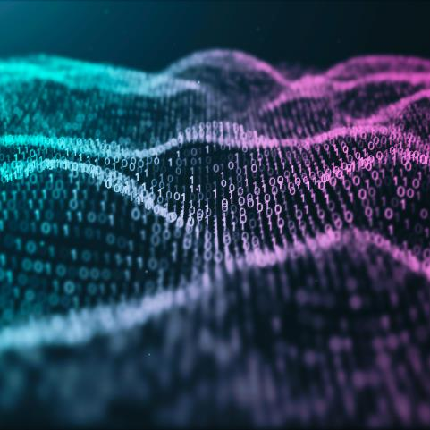
Machine Learning affects human decision in several areas, and this includes:

Slide 3
Judiciary process
In Estonia, the judiciary system is becoming emptied of human workforce and recently, for crimes where claimed compensation is less than seven thousand euros, Artificial intelligence can determine the culpability of the suspect.
In the US, more than 60 jurisdictions use AI to predict the probability of a repeated offence using a machine learning software: COMPAS.

Slide 4
Judiciary process
The superior court in Los Angeles has a machine learning software called ‘Gina The Avatar’, which enables court users to carry out court transactions without setting foot in a court.
In the same LA, researchers are currently working on a Jury Chatbot which will leverage features like natural language understanding, Question and Answer maker and translation services. This Chatbot is being built on the Microsoft Cognitive Services Platform.

Slide 5
Recommendation Engines
This is a benign use of machine learning and it already affects our decision making daily like Netflix, YouTube, Amazon. With the aid of machine learning, our choices of what to series to watch or what items to purchase are subtly or overtly introduced to us daily.
Siri is a machine learning speech recognition software which uses deep learning algorithm by which we talk to the internet.

Slide 6
Combating Crime
CRUSH(Crime Reduction Using Historical Data) is a machine learning algorithm designed to use predictive analysis of historical data to reduce crime in a specific area. There was pilot project launched in Memphis, Tennessee, 2005, by IBM. Basically, historical data of where crimes had been committed in the past was used to predict potential crimes, thus reducing crime rate. It has raised concerns with civil right groups when it comes to ethical issues, but it is still very much in use till today, not just overtly.

Slide 7

Summary
Human decisions are no longer just about what we think alone, it is now about predictions of what we would think or do considering that daily, we use search engines and ‘talk’ to Siri and make purchases based on suggestions on amazon. Machine learning models have direct and indirect influence on our decisions and more of this will happen as machine learning models are trained to have better accuracies and outputs. There are advances in machine learning model applications in all spheres of life that proves this point.

Slide 8
References
Using Artificial Intelligence in Judiciary: It's already more than You Think (techlawdialogue.net)
The impact of artificial intelligence on human society and bioethics - PMC (nih.gov)
How does machine learning affect your everyday life? (phrasee.co)
Machine Learning for Decision Making | by Emily Glassberg Sands | Teconomics | Medium

